Slide 1



Cybersecurity Project
Part 2
Tyler Olson

Slide 2


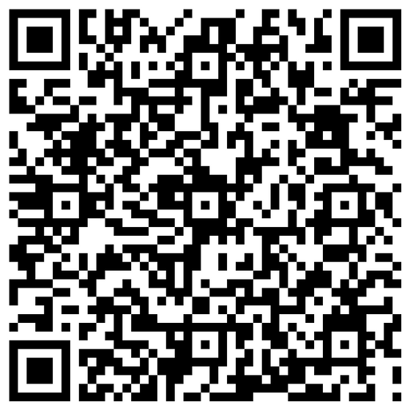
Attendance survey

Slide 3

Recap
1 | CTF Basics
2 | OSINT
3 | Malware Analysis
4 | Log Analysis
5 | Forensics/Incident response

Slide 4
Whats today?
1 | Welcome back / Reintroduction
2 | Events overview
3 | Networking
4 | Getting certified (Where to look, what to study)

Slide 5
Quick Re-intro
Learning along with you
Feel free to email or send me any kind of feedback / ideas. I want to help you learn what you want!
I’ll usually stay after we finish everything in case you want to chat / work on something!

Slide 6


Competitions
National Cyber League
Sp4rkcon CTF
New MSU comp
Compete against industry profesionals during the conference. great chance to network and learn
Registration is on site
Saturday, April 18, 2026, 9:00 a.m. to 5:00 p.m.
If similar to last year, small CTF competition
Prep will be done once we learn more about it / content
March 26th - 28th
Second season of NCL will be soon
Apr 10 - Apr 12 : Individual Game
Apr 24 - Apr 26 : Team Game

Slide 7
Competitions pt.2
CCDC
CTFtime.org
If you are interested in competing in CCDC next academic year, please reach out to me or the advisor: Dr. Liu
ZongxiLiu@missouristate.edu
to329s@missouristate.edu
There is a competition every single weekend.
Great practice for those interested.
Sign up for those interested

Slide 8
Groups time!
Group yourself in groups of 3 - 5 people! Raise your hand if you need a group!

Slide 9
Networking
Name / Year
If you were to choose an area of focus in cyber what would it be?
What originally got you interested in IT/cyber?
What’s something you want to work on but haven’t yet?
What’s a project or class you actually enjoyed?
What’s a skill you’d love to pick up this semester?
Share your linked-in/other contact information (if you wish)

Slide 10



Why Certify?
Recruiters + certs
Reimbursement by A-Bits
Many of our courses go over their content
What to certify?
Security+ (Analysts, Engineering)
A+ (Help desk, Intro IT)
Net+ (Network engineering, basis for sec+)
https://pauljerimy.com/security-certification-roadmap/
Questions?

Slide 11

Career advice
Take every opportunity you can
Don’t let denial stop you
Solicit feedback from interviews
Stay in contact with the recruiter
Personal project show passion
Free cloud credits + trials
Google cloud, Splunk, Wazuh
Learning platforms
Network
Reach out too me if you need any help!
My linkedin is on github!

Slide 12
Thanks!
Have a great weekend!

